Slide 1

Syracuse University
Data Science Portfolio
Kevin Vogel

Slide 2
Agenda
About me
My journey to Syracuse
What data science is
My projects
Records – database creation and querying
United Way – using data for good
Unstructured data – something from nothing
Key takeaways
Describe practice areas | Collect and organize data | Identify patterns in data | Develop alternative strategies | Develop an implementation plan
Develop communication skills regarding data with relevant professionals | Privacy and ethical dimension

Slide 3

About me
BS, Economics and Finance (2012)
Veteran, USMC (2013-2017)
MBA, SCM (2017-2018)
LSS Black Belt (2020)
MS, Data Science (2020)
Describe practice areas | Collect and organize data | Identify patterns in data | Develop alternative strategies | Develop an implementation plan
Develop communication skills with relevant professionals | Privacy and ethical dimension

Slide 4

My journey to Syracuse
Hadn’t touched a keyboard in years
Exposure to coding in internship
Passion for development
Learner
Quite a development from where I was to where I am today.
Describe practice areas | Collect and organize data | Identify patterns in data | Develop alternative strategies | Develop an implementation plan
Develop communication skills with relevant professionals | Privacy and ethical dimension

Slide 5
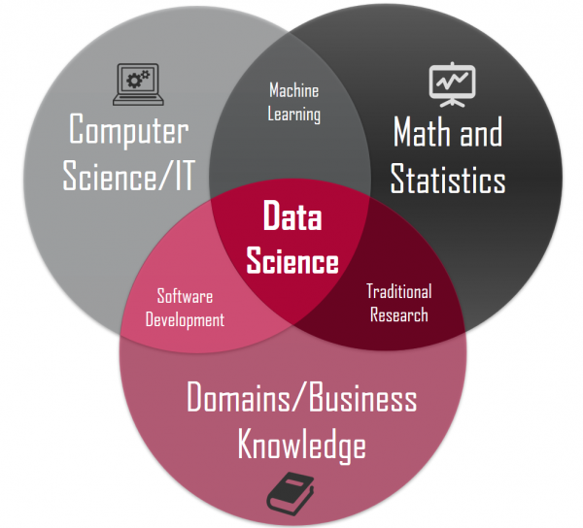
What data science is
Not
Wizard magic
The cure to world hunger
Practical application / convergence
Math
Computer science
Subject matter expertise
Describe practice areas | Collect and organize data | Identify patterns in data | Develop alternative strategies | Develop an implementation plan
Develop communication skills with relevant professionals | Privacy and ethical dimension

Slide 6

Records – database creation & querying
Problem statement | My father has thousands and thousands of vinyl records. Many of them are in good, playable shape while others are mint or unplayable due to sheer use. There is no method of recording or archiving what he has or what shape it’s in.
Goal | Create a database that is able to be queried by an end user. Must maintain records of artist, album, year produced, shape, and recording studio or publisher.
Scope | My father’s 45, 78, and 33 collection. Reel to reel is out of scope.
Team | Kevin Vogel, Johnny Vogel
Describe practice areas | Collect and organize data | Identify patterns in data | Develop alternative strategies | Develop an implementation plan
Develop communication skills with relevant professionals | Privacy and ethical dimension

Slide 7
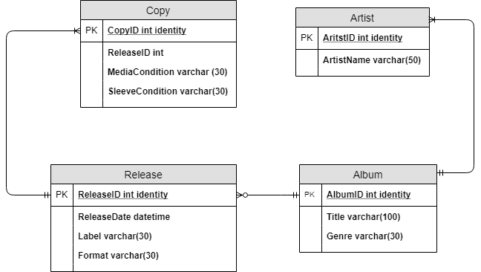
Records – database creation & querying
Conceptual model
Voice of customer
Copy
Artist
Release
Album
Describe practice areas | Collect and organize data | Identify patterns in data | Develop alternative strategies | Develop an implementation plan
Develop communication skills with relevant professionals | Privacy and ethical dimension

Slide 8
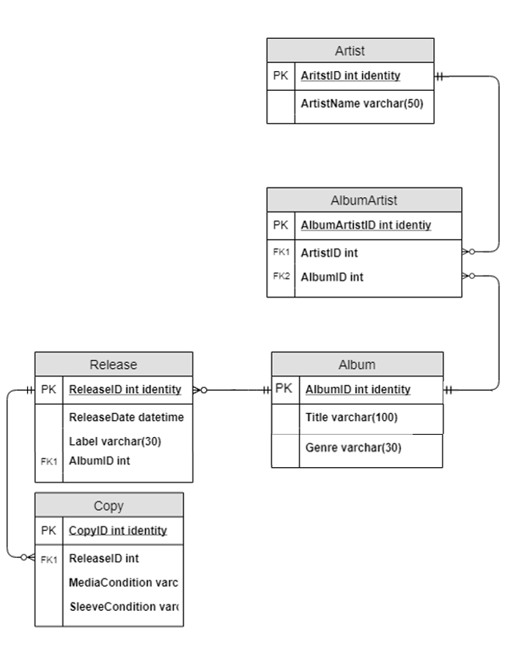
Records – database creation & querying
Normalized, logical model
Requirements:
Attributes are specified
Primary keys are specified
Foreign keys are specified
Normalization (3NF) at this level
Describe practice areas | Collect and organize data | Identify patterns in data | Develop alternative strategies | Develop an implementation plan
Develop communication skills with relevant professionals | Privacy and ethical dimension

Slide 9
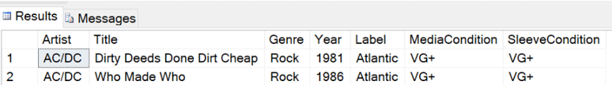
Records – database creation & querying
Created a front end
Tested
Improved
Summarization
Future state: link to value
Describe practice areas | Collect and organize data | Identify patterns in data | Develop alternative strategies | Develop an implementation plan
Develop communication skills with relevant professionals | Privacy and ethical dimension

Slide 10

United Way – using data for good
Problem statement | Access to help is one of the biggest barriers to receiving help. The United Way needs a means improving their outreach. Are their locations optimally placed?
Goal | Determine where the United Way should place locations in order to do the greatest good.
Scope | Tennessee, Kentucky, and Ohio
Team | Kevin Vogel, Ben Harwood, Nina Williams, Kyle Wass
Describe practice areas | Collect and organize data | Identify patterns in data | Develop alternative strategies | Develop an implementation plan
Develop communication skills with relevant professionals | Privacy and ethical dimension

Slide 11
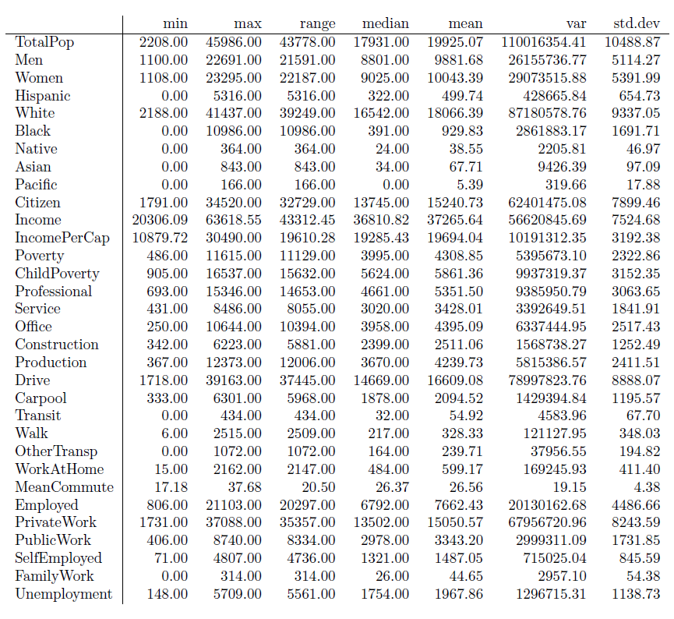
United Way – using data for good
Obtain data from census bureau
We thought that the census would be by county… it is not
Clean data so that census tracts match up with counties as that is how the United Way seems to place locations
Begin exploring with histograms, density plots, boxplots, and summary data
Clean data
Describe practice areas | Collect and organize data | Identify patterns in data | Develop alternative strategies | Develop an implementation plan
Develop communication skills with relevant professionals | Privacy and ethical dimension

Slide 12
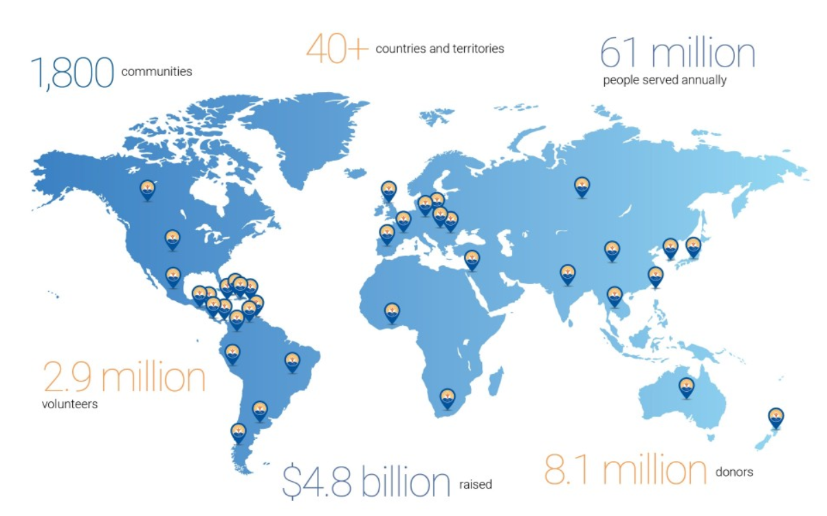
United Way – using data for good
Gathered data from individual branches annual reports
There are 95 counties in TN alone, you can imagine how long this took
Joined this data on county as a flag
Next step was to try and predict whether a county had or did not have a United Way using the data we had gathered from the census
Describe practice areas | Collect and organize data | Identify patterns in data | Develop alternative strategies | Develop an implementation plan
Develop communication skills with relevant professionals | Privacy and ethical dimension

Slide 13
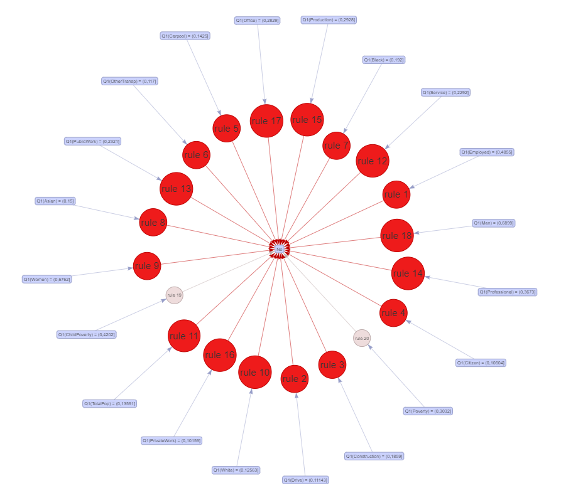
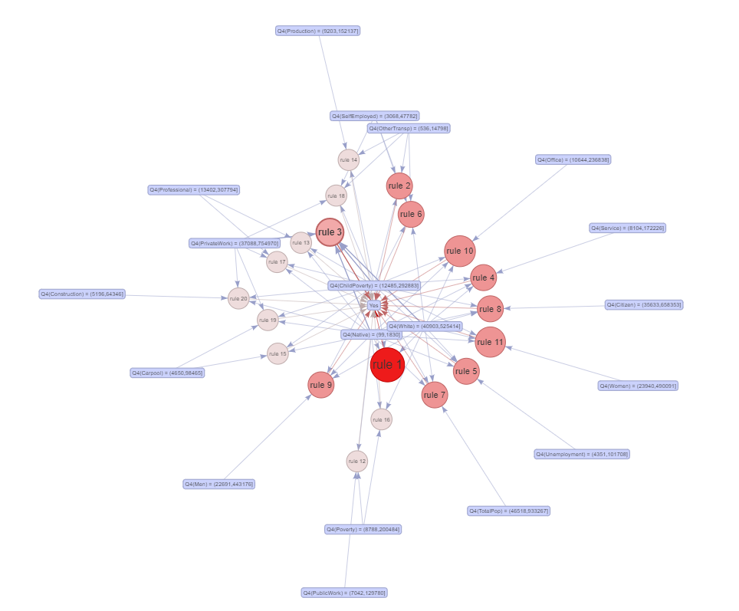
United Way – using data for good
Describe practice areas | Collect and organize data | Identify patterns in data | Develop alternative strategies | Develop an implementation plan
Develop communication skills with relevant professionals | Privacy and ethical dimension

Slide 14
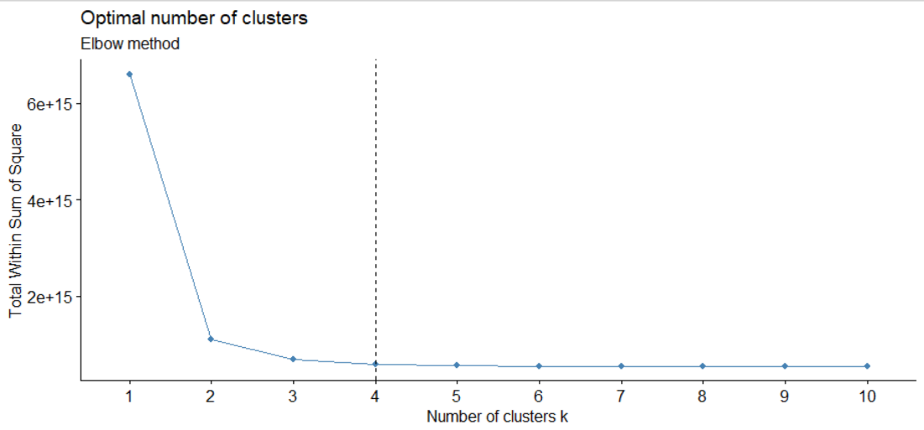
United Way – using data for good
Optimal number of clusters was determine using several methods.
We chose to move forward with four clusters as it proved to be the most robust without overtraining.
Two clusters gets you most of the way there but there is still some gain to be had from clustering a bit further.
Describe practice areas | Collect and organize data | Identify patterns in data | Develop alternative strategies | Develop an implementation plan
Develop communication skills with relevant professionals | Privacy and ethical dimension

Slide 15
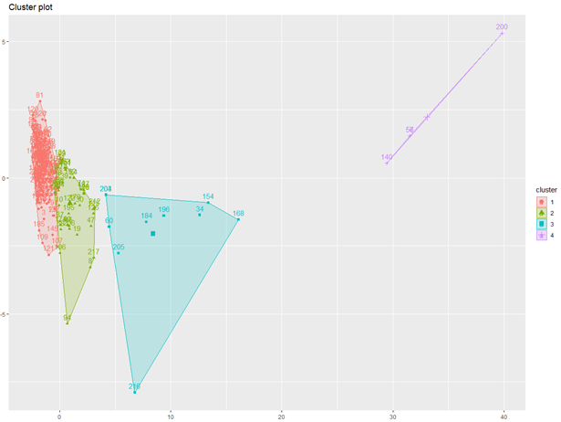
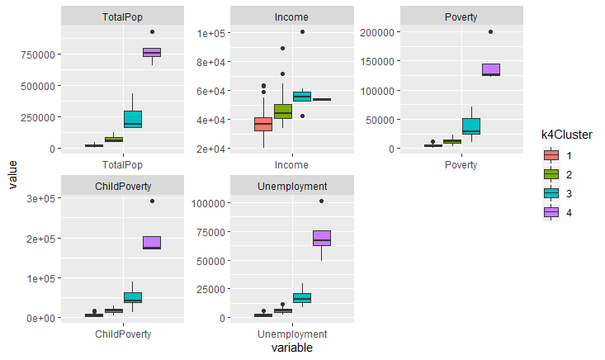
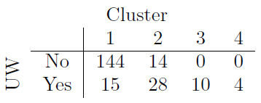
United Way – using data for good
Describe practice areas | Collect and organize data | Identify patterns in data | Develop alternative strategies | Develop an implementation plan
Develop communication skills with relevant professionals | Privacy and ethical dimension

Slide 16
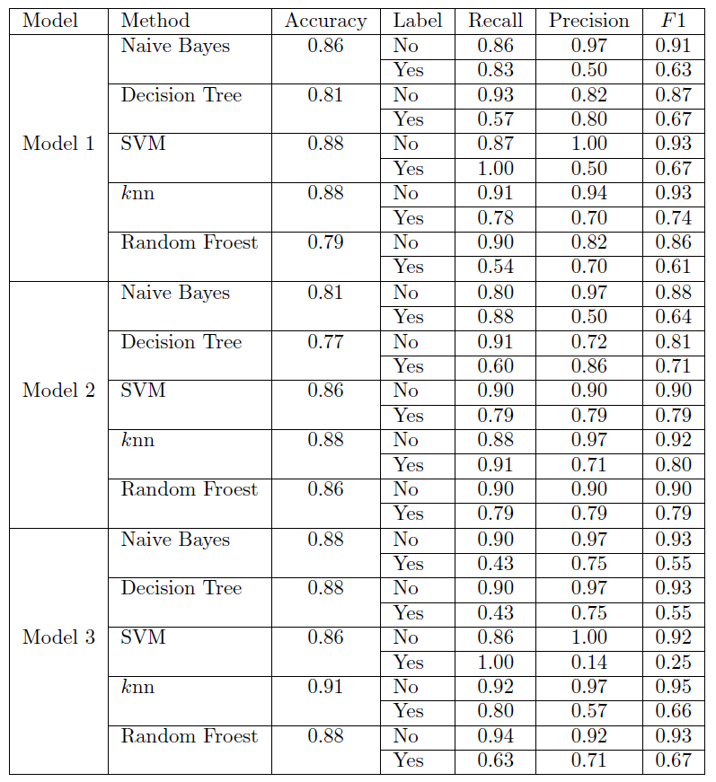
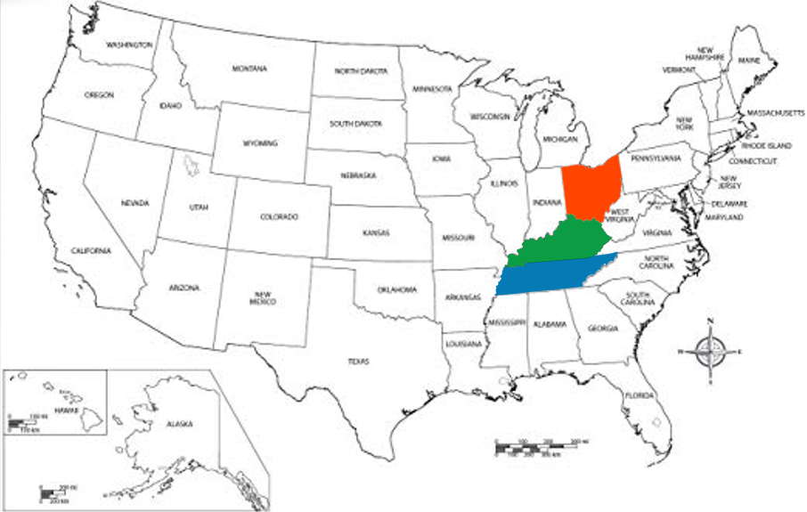
United Way – using data for good
Describe practice areas | Collect and organize data | Identify patterns in data | Develop alternative strategies | Develop an implementation plan
Develop communication skills with relevant professionals | Privacy and ethical dimension

Slide 17

United Way – using data for good
We proposed several counties that were underserved in each of the states in which we modeled.
Given a chance to expand upon our model with more granular data from United Way, I believe that we could implement real change that would greatly affect the lives of many.
Describe practice areas | Collect and organize data | Identify patterns in data | Develop alternative strategies | Develop an implementation plan
Develop communication skills with relevant professionals | Privacy and ethical dimension

Slide 18
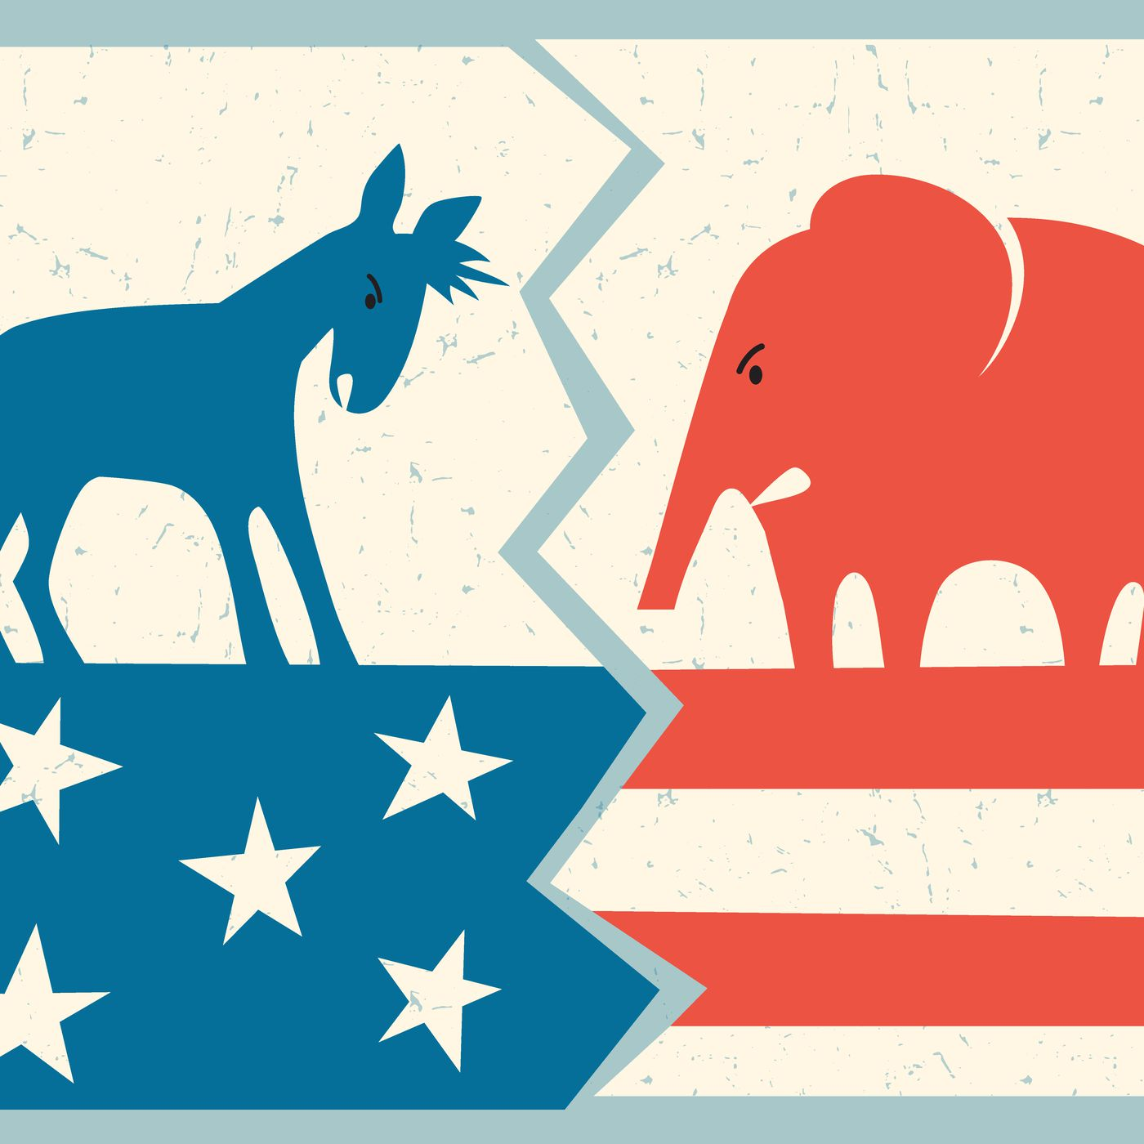
Unstructured data – something from nothing
Problem statement | Politicians speak in tongues. Politicians exhibit double speak. How do you know if a politician is lying – they’re talking. Can we tell when someone is speaking whether they hold democratic or republican beliefs?
Goal | Create a text speech classifier from inaugural gubernatorial addresses that predicts whether the speaker is a democrat or republican.
Scope | Democrats, republicans, last 20 years
Team | Kevin Vogel, Ben Harwood
Describe practice areas | Collect and organize data | Identify patterns in data | Develop alternative strategies | Develop an implementation plan
Develop communication skills with relevant professionals | Privacy and ethical dimension

Slide 19
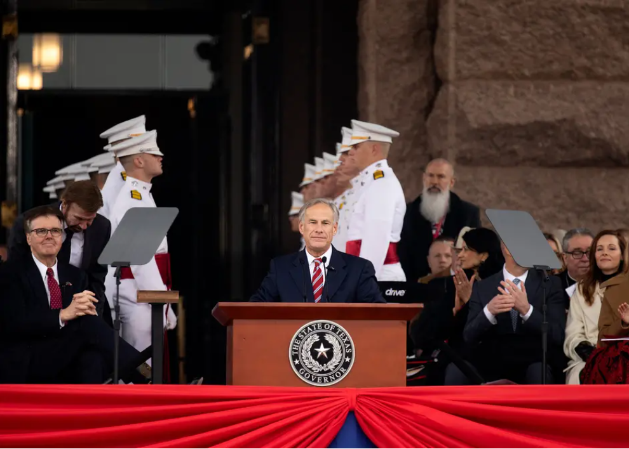
Unstructured data – something from nothing
We started this project by scouring the interwebs for gubernatorial speeches from 20 different states.
For each state, we looked for a republican and a democrat governor in the last 20 years and collected those speeches.
Arizona, Connecticut, Illinois, Kentucky, Louisiana, Maine, Massachusetts, Michigan, New Hampshire, and Vermont
These speeches were put into a corpus.
Describe practice areas | Collect and organize data | Identify patterns in data | Develop alternative strategies | Develop an implementation plan
Develop communication skills with relevant professionals | Privacy and ethical dimension

Slide 20
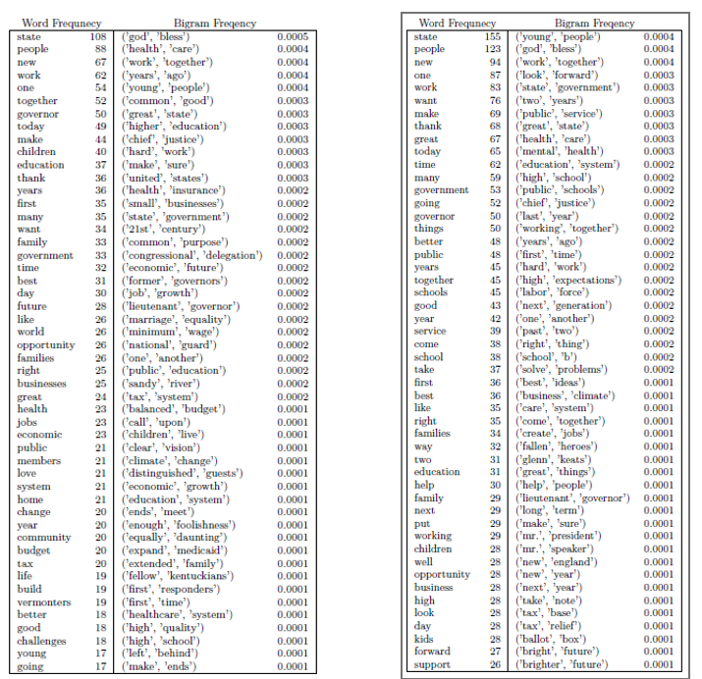
Unstructured data – something from nothing
Some stop words were removed, and the entire text set was lemmatized.
Bigram and trigram frequencies were determined after some cleaning of the data.
Governors sure do love young people, health care and god sending down his blessings when they are pandering, don’t they?
Describe practice areas | Collect and organize data | Identify patterns in data | Develop alternative strategies | Develop an implementation plan
Develop communication skills with relevant professionals | Privacy and ethical dimension

Slide 21
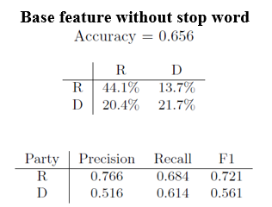
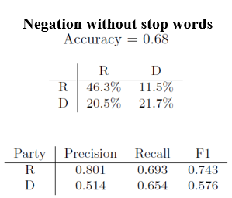
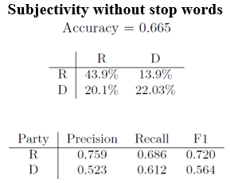
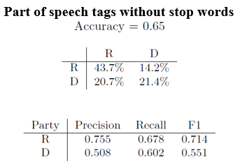
Unstructured data – something from nothing
We tried several models but ultimately could not classify with accuracy greater than 68% accuracy.
There was some imbalance in the datasets that might have led to some of the issues we saw.
Republicans speak longer on average than democrats do.
Describe practice areas | Collect and organize data | Identify patterns in data | Develop alternative strategies | Develop an implementation plan
Develop communication skills with relevant professionals | Privacy and ethical dimension

Slide 22

Unstructured data – something from nothing
Republicans were more likely to toe the line than Democrats.
If we can predict the likelihood of someone’s political leaning or proclivity from their speech, we can probably determine who the candidates are that are most likely to ascend the ranks as they will likely be the ones that most embody the party values and do not rock the vote.
Describe practice areas | Collect and organize data | Identify patterns in data | Develop alternative strategies | Develop an implementation plan
Develop communication skills with relevant professionals | Privacy and ethical dimension

Slide 23

Key takeaways from this program
1. Perfect data does not exist. At some point you must make do with the data that you have and make the best choice that you can given what you know and what you have gleaned.
2. Every project should be iterative. Beware the project that goes smoothly from beginning to end without going back on occasion – you probably did something wrong. Invite critique and criticism.
3. Meaningful communication with teammates and superiors is key. If you can’t collaborate and work with others, you can’t work effectively. If you can’t communicate your work to someone in plain language, you can’t work effectively. Throughout this program we crafted presentations that helped improve
Describe practice areas | Collect and organize data | Identify patterns in data | Develop alternative strategies | Develop an implementation plan
Develop communication skills with relevant professionals | Privacy and ethical dimension

Slide 24
Syracuse University
Data Science Portfolio
Kevin Vogel

Slide 25
View the presentation
https://1drv.ms/v/s!AnWeAKi16AIhhaMyd_-dnPEUS96s_g?e=mJIEes

